Slide 1




MapQuest Rest API
EpicMaps: Your Journey Starts
Here In the age of digital transformation, navigation has transcended beyond mere point A to point B travel. EpicMaps is at the forefront of this revolution, offering a comprehensive and intuitive navigation solution that caters to the diverse needs of modern society.
Hot Tea & Cold Beer

Slide 2
Overview of the Application Features
Multi-Modal Transport Options
Live Traffic Updates
Avoid congestion with real-time traffic information and rerouting.
Choose from driving, walking, cycling, or public transport to get the best route for your journey.
Offline Maps
Personalized Experience
Navigate without an internet connection in remote areas or to save on data usage.
Save your favorite places, set up preferred routes, and receive recommendations based on your travel history.

Slide 3
Reasons for selecting the specific features
Our team's decision to incorporate specific features into EpicMaps was driven by a combination of user-centric research, technological trends, and strategic planning. Here are the key reasons behind our feature selection:
User-Centric Design
Feedback Loop: We actively sought feedback from potential users through surveys and focus groups, which highlighted the demand for features like real-time traffic updates and multi-modal routing.
Usability Studies: Through usability testing, we identified the need for a simple yet powerful interface that could cater to both tech-savvy users and those less familiar with navigation apps.
Technological Innovation
Cutting-Edge Tech: We wanted to leverage the latest advancements in geolocation and mapping technologies to provide accurate and efficient navigation.
API Integration: By integrating with various APIs, we ensured that our app could offer enriched data, such as live traffic conditions and points of interest.
Scalability and Future Growth
Foundation for Expansion: We designed our app's architecture to be scalable, allowing us to easily add new features and expand our services in the future.
Data-Driven Development: By implementing features that allow us to collect anonymized data on travel patterns, we can continuously refine and enhance the user experience.
Accessibility and Inclusivity
Wide Reach: It was important for us to create an app that could be used by a diverse audience, so we included features like adjustable text sizes and voice-guided navigation for users with different needs.
By focusing on these areas, we aimed to create an application that not only meets the current needs of our users but also anticipates future trends and prepares for ongoing enhancements. Our goal is to make EpicMaps a reliable companion for all your navigation needs, today and in the future.

Slide 4
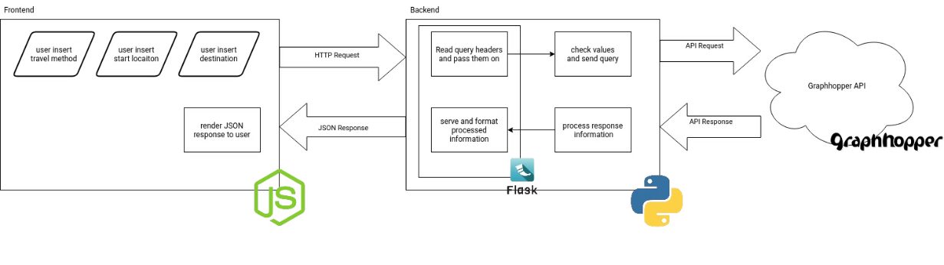
Application Code Structure and Organization

Slide 5
Frontend
User Input: The frontend interface allows users to input their travel method, start location, and destination. This is likely facilitated through a form or interactive map interface.
HTTP Request: Once the user submits their input, an HTTP request is generated and sent to the backend server. This request includes the user’s travel preferences and location details.
JSON Response Rendering: After the backend processes the request, the frontend receives a JSON response. This response contains the routing information, which the frontend then renders for the user, likely displaying the route on the map and providing navigation instructions.

Slide 6
Backend
Query Header Reading: The backend server reads the query headers received from the frontend’s HTTP request. These headers may contain additional information such as the user’s session data or authentication tokens.
Value Checking and Querying: The backend checks the values received (travel method, start location, destination) and constructs a query to send to the GraphHopper API.
Information Processing: Once the GraphHopper API responds, the backend processes this information, which may involve formatting the data into a user-friendly format or filtering the data based on specific criteria.
JSON Response: The processed information is then sent back to the frontend in the form of a JSON response, which includes the route details, instructions, and any other relevant data.

Slide 7
GraphHopper API:
API Request: The backend sends an API request to the GraphHopper API, which is a third-party service providing routing information. The request includes the coordinates or addresses of the start and destination locations, as well as the specified travel method.
API Response: The GraphHopper API processes the request and returns the routing information, including the best route, estimated travel time, and step-by-step instructions.
This architecture demonstrates a clear separation of concerns, with the frontend responsible for user interaction and the backend handling data processing and communication with external services. The use of Node.js in the frontend suggests a JavaScript-based application, while Flask in the backend indicates a Python-based server environment.
The system is designed to be scalable and modular, allowing for easy updates to the frontend or backend without affecting the other parts of the application. It also highlights the importance of external APIs in modern web development, providing powerful features without the need to develop complex algorithms from scratch.

Slide 8
Detailed comments and documentation
# Import necessary libraries
import requests
# Define the base URL for the GraphHopper API
GRAPH_HOPPER_BASE_URL = "https://graphhopper.com/api/1/"
# Define the API key for GraphHopper API
API_KEY = "your-api-key-here"
def geocode_location(location_name):
"""
Geocode a location name to latitude and longitude using the GraphHopper Geocoding API.
Parameters:
location_name (str): The name of the location to geocode.
Returns:
tuple: A tuple containing the latitude and longitude of the location, or (None, None) if not found.
"""
# Construct the full URL for the geocoding request
geocode_url = f"{GRAPH_HOPPER_BASE_URL}geocode"
# Set up the parameters for the request
params = {
"q": location_name,
"limit": 1,
"key": API_KEY
}
# Make the GET request to the GraphHopper Geocoding API
response = requests.get(geocode_url, params=params)
# Check if the request was successful
if response.status_code == 200:
# Parse the JSON response
data = response.json()
# Check if any results were returned
if data["hits"]:
# Extract the latitude and longitude from the first result
lat = data["hits"][0]["point"]["lat"]
lng = data["hits"][0]["point"]["lng"]
return lat, lng
else:
# No results found, return None values
return None, None
else:
# Request failed, return None values
return None, None
# Example usage of the geocode_location function
latitude, longitude = geocode_location("Berlin, Germany")
print(f"The coordinates of Berlin, Germany are: Latitude {latitude}, Longitude {longitude}")
This code includes:
Descriptive Comments: Clear explanations of what the code is doing at each step.
Function Documentation: A docstring that describes the purpose, parameters, and return value of the geocode_location function.
Error Handling: Checks to ensure that the API request was successful and handles cases where no results are found.
Example Usage: A demonstration of how to call the function and use its return values.
This level of documentation ensures that any developer, regardless of their familiarity with the project, can understand the purpose and functionality of the code. It also provides a solid foundation for future enhancements and maintenance.

Slide 9



Explanation of key functionalities
Voice Navigation
Offline Maps
Social Integration
Personalized Experience
Hands-Free Operation: Implementing voice commands to allow users to navigate menus and maps without physical interaction, enhancing safety, especially while driving.
Downloadable Maps: Enabling users to download maps for specific regions or routes, ensuring access to navigation even in areas with poor or no internet connectivity.
Route Sharing: Allowing users to share their current routes or favorite destinations with friends and family via social media platforms or messaging apps.
Contextual Alerts: Sending personalized notifications for relevant travel information based on the user's location, time, and habitual routes.

Slide 10
Challenges faced during development
1
Technical Hurdles
Integrating real-time traffic data into EpicMaps was a complex task that required us to process large volumes of data efficiently. Ensuring accuracy and speed was paramount to provide users with reliable navigation.
2
Collaborative Problem-Solving
Our team adopted an agile methodology, allowing us to work closely with cross-functional teams, including developers, designers, and product managers. Regular stand-ups and sprint reviews helped us stay aligned and address issues promptly.
3
Technology Trends
We observed a growing trend in the use of voice-assisted devices, which influenced our decision to prioritize the development of voice navigation features for future releases.

Slide 11
EpicMaps: A Summary of Features and Benefits
Real-Time Traffic Updates
Multi-Modal Routing
Stay ahead of the traffic with live updates that help you avoid delays.
Whether you're driving, walking, or cycling, EpicMaps provides the best route options tailored to your mode of transportation.
Intuitive User Interface
Personalized Navigation
Our user-friendly design ensures that finding your way is a breeze, no matter where you are.
EpicMaps learns from your preferences to offer routes that are customized just for you.
The EpicMaps Advantage
Our commitment to innovation and user satisfaction has driven us to create an application that not only meets the basic needs of navigation but also enhances your travel experience with advanced features. With EpicMaps, you gain a reliable travel companion that understands your preferences and adapts to your lifestyle.

